Slide 1

Hotel aggregator Power-Bi Dashboard
By Digvijay Surve

Slide 2
Table of contents
01
02
What is the project
Objectives and dataset
03
04
Discussion and Dashboard
Conclusions and Insights

Slide 3
What is this project?
The project offers interns a dynamic learning experience through the utilization of Power BI, enabling
students to delve into the intricacies of hotel aggregator listings. Through interactive Power BI dashboards, interns explore the geographical spread, pricing dynamics, host attributes, and review ratings, gaining a comprehensive understanding of the market landscape.

Slide 4
Objectives and dataset
The project analyzes a rental platform's data to create interactive Power BI dashboards showing
geographical distribution, pricing trends, host characteristics, and reviewscores. Reports detail availability patterns, property preferences, and factors influencing guest satisfaction, with recommendations for hosts and the platform.
Goals include understanding geographical insights, pricing dynamics, host performance, review scores impact, and property analysis to enhance platform performance and user satisfaction.

Slide 5
Objectives and dataset
The dataset comprises various attributes related to listings, hosts, reviews, and availability. The objective is to create comprehensive visualizations and insights that shed light on trends, patterns, and factors influencing the performance of listings.
Dataset Description:
6. name: listing name and some attributes of the listing.
1. id: Unique identifier for each listing.
7. description: Description of the listing.
2. listing_url: URL of the listing.
8. ... (and many more columns capturing details about
hosts, location, property type, room details, amenities,
3. scrape_id: Identifier for the data scraping event.
4. last_scraped: Date of the last data scrape.
pricing, availability, reviews, and other relevant
information)
5. source: Source of the listing information.

Slide 6
Discussion and Dashboard
To create the dashboard, students should load and handling the dataset like:
Removing unused columns like listing_url, neighborhood_overview, and so on.
Check the duplicated rows using the unique identifiers of the table.
Split and handle some columns like "Hostlocation" and "name" columns to create more effective columns.
Correct the structureerrors like in “host_response_rate”, “review_scores_rating” columns.
Creating calculated columns using DAX like "HostMegred”,” CleanOverAllRating” columns

Slide 7
Discussion and Dashboard
Some Simple DAX examples:
host_email = IF(CONTAINSSTRING('Hotel Aggregator dataset'[host_verifications],"email"),
"Yes",
"No“)
CleanOverAllRating =
IF(ISBLANK('Hotel Aggregator dataset'[StarRating]), 'Hotel Aggregator dataset'[review_scores_rating], 'Hotel Aggregator dataset'[StarRating])

Slide 8
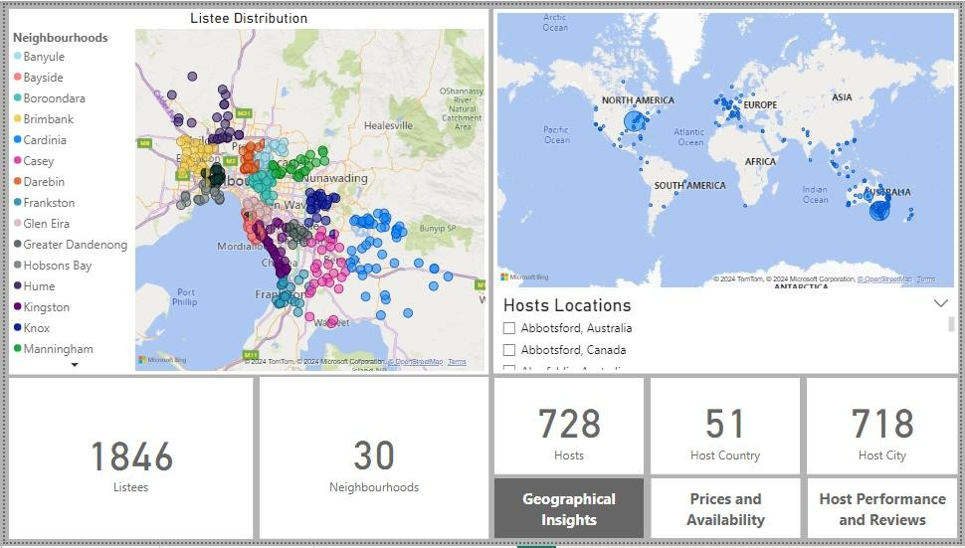
Discussion and Dashboard
Geographical Insights: we can check
visually map listing distributions to pinpoint popular neighbourhoods and delve into geographical concentration to understand listing and host placements.

Slide 9
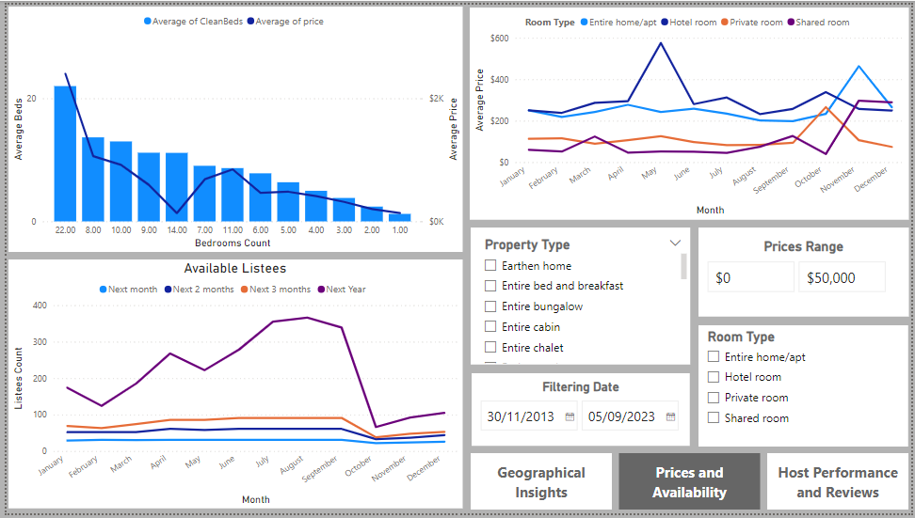
Discussion and Dashboard
Prices and Availability: we scrutinize
pricing patterns across various property and room types, and accommodation capacities. They further delve into listing availability trends over time, pinpointing peak periods of demand.

Slide 10
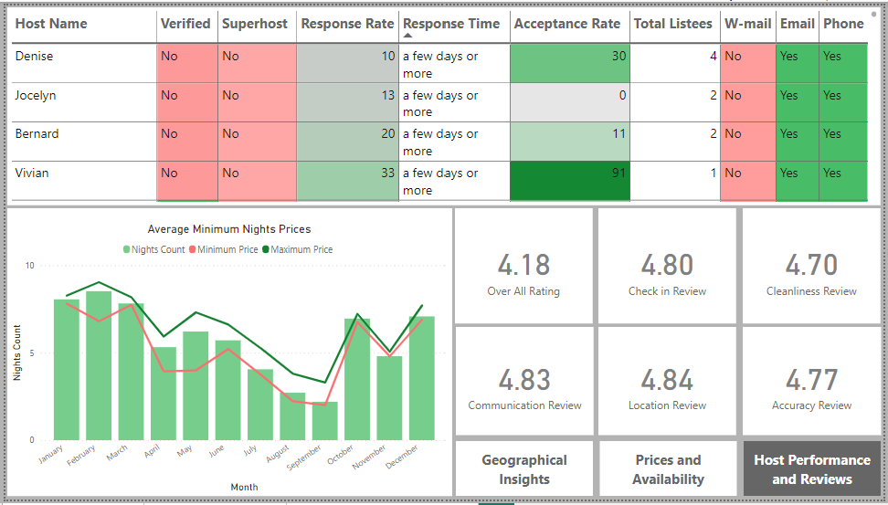
Discussion and Dashboard
Host Performance and Reviews: we delve
into review scores, assessing their influence on listing performance, and pinpoint areas for enhancement through detailed review category analysis.

Slide 11
Conclusions and Insights
The city with the most listings is Melbourne, Australia, with 800 listings spread across 30 neighborhoods.
The highest availability of listings occurred in March 2020, January, April, and August 2023, for durations of
30, 60, 90, and 360 days, respectively.
The morebedrooms you order, the higher the price, but ordering 14 bedrooms can yield significantly lower prices in many places.
From 2018 to 2022, shared and private rooms have been competitors, with shared rooms being cheaper
most of the time. However, the most sought-after property type throughout this period has been entire homes.
Factors influencing guest satisfaction includecleanliness, amenities, communication, and overall experience.

Slide 12


Thanks You!
……………………………………………………………………………
CREDITS: This presentation template was created by Slidesgo, and includes icons by Flaticon and infographics & images by Freepik
Please keep this slide for attribution

